Slide 1
Pavement Defects Detection Based on Yolov5 and Generative Adversarial Network
DSPS Conference 2022
Group Members:
Tianjie Zhang,
Steven Kim,
Amanda Mullins,
Yang Lu
Mar. 23, 2022

Slide 2
Overview
Introduction
Data
Methodology
Results
Conclusion
Notes:
Speak out all points

Slide 3
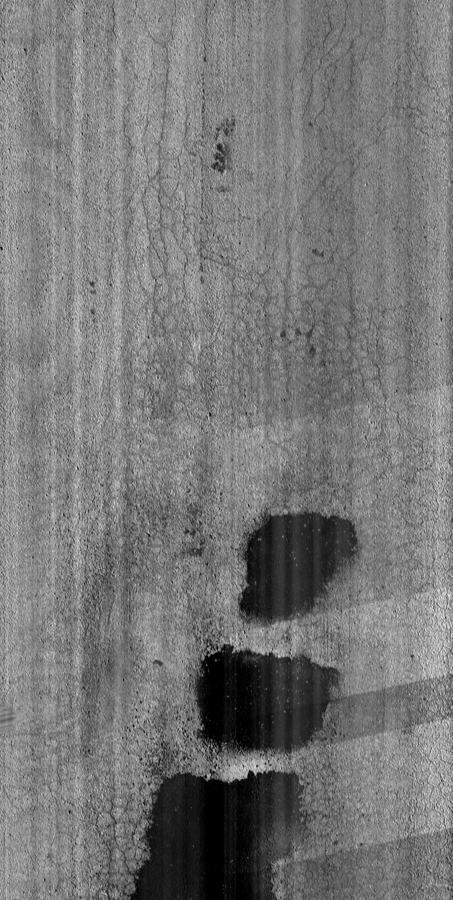
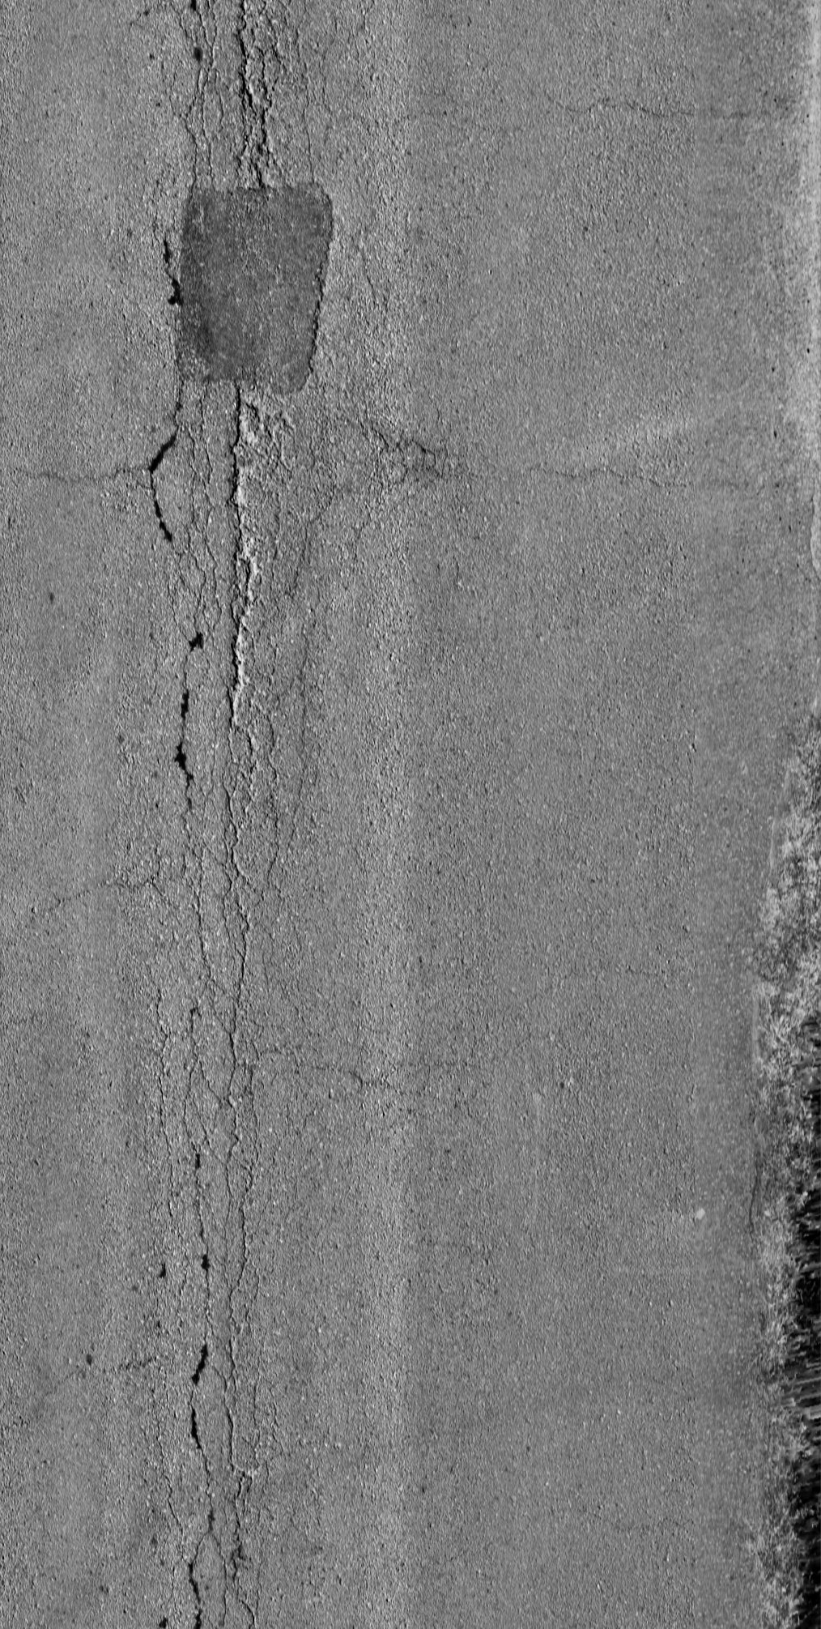
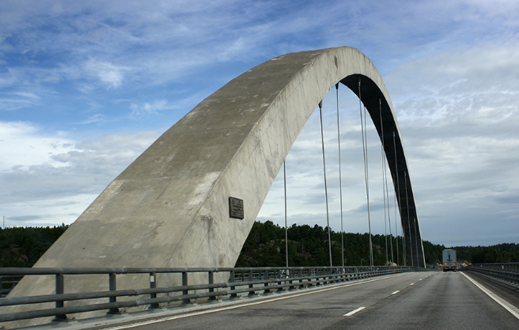
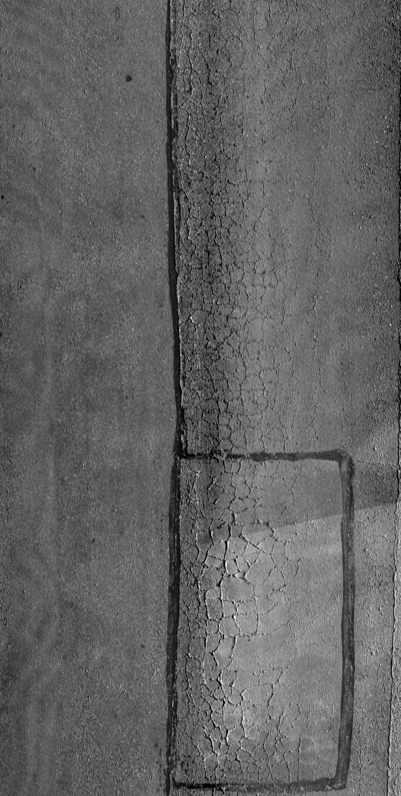
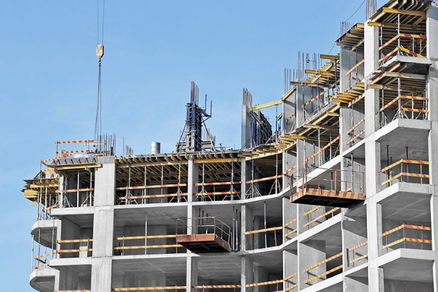
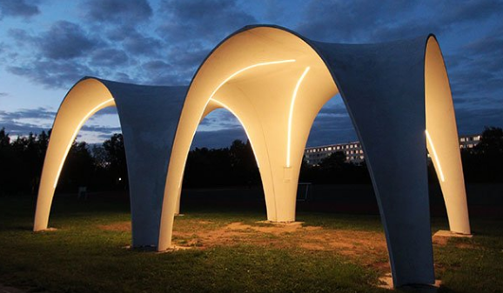
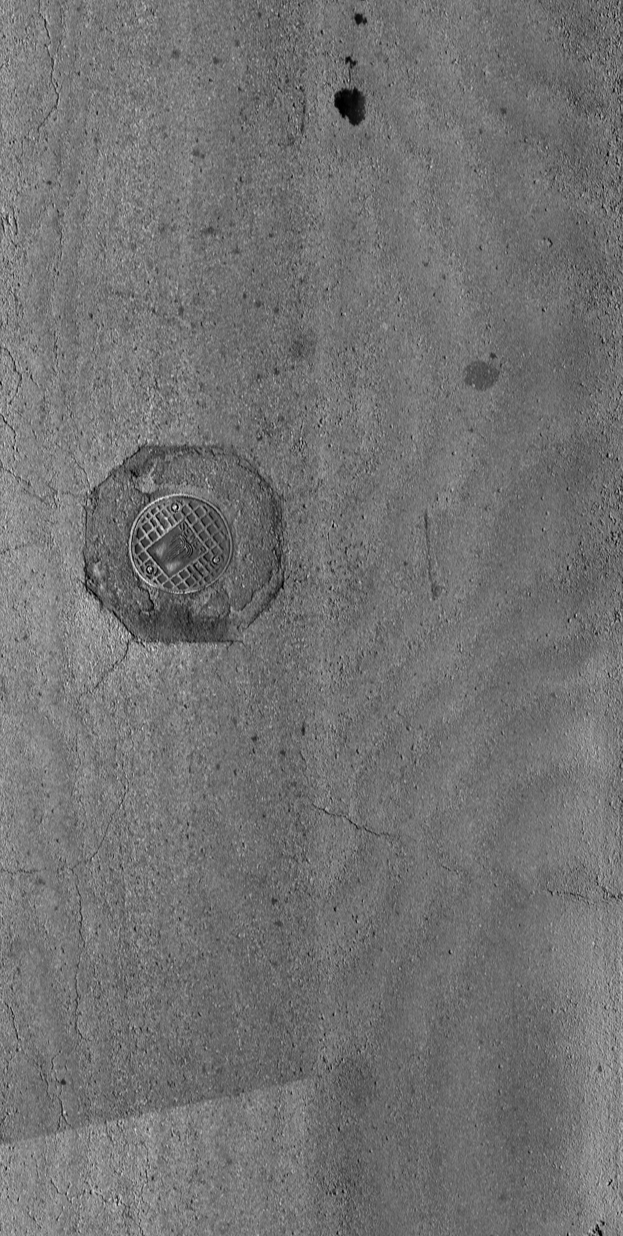
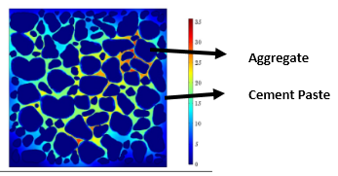
Introduction
Pavement distresses:
Cracking
alligator
transverse
block
longitudinal
Patching
Sealing
Manholes
Picture Credit: change the images
Intelligent pavement detection and identification becomes a significant task.
Notes:
Tranditional detecting methods are time-consuming and laber-intensive. Thus,

Slide 4
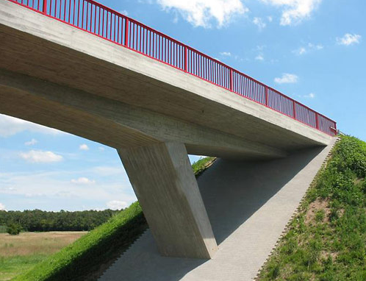
Introduction
Pavement distresses:
Cracking
alligator
transverse
block
longitudinal
Patching
Sealing
Manholes
Picture Credit: change the images
Intelligent pavement detection and identification becomes a significant task.
Notes:
Tranditional detecting methods are time-consuming and laber-intensive. Thus,

Slide 5

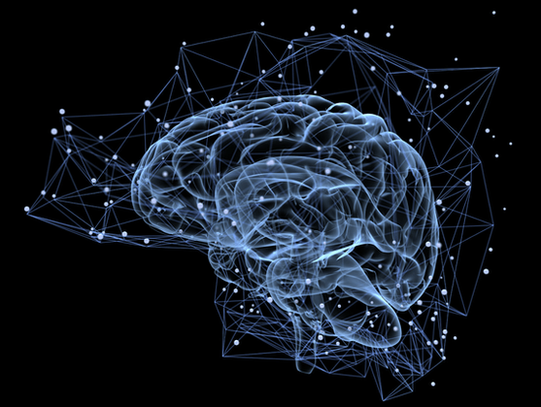
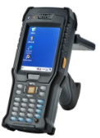
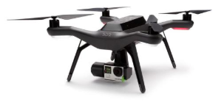
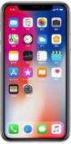
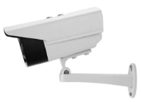
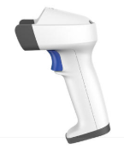
Introduction
Machine Learning Convolutional methods deep Learning
K-Means RF SVM Threshold Edge Yolo CNN GAN
Accurate
Pavement Distress Detection
Robust
Auto
Data

Slide 6
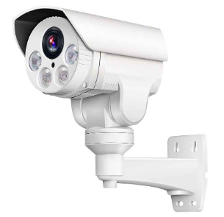
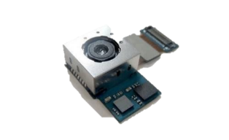


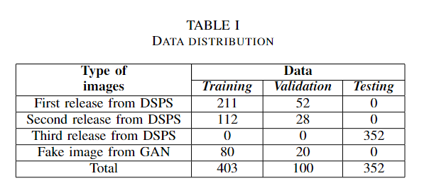
Data
Real Images
From: Organizers of DSPS22 (Kansas city, Jefferson city, Columbia, Missouri)
Distress: 7 main distress types
Resolution: 2011×1014 pixels
Annotation: The second release data was annotated by our team members while the first release was annotated by Sponsor.
Fake Images
From: Generative Adversarial Network
Annotation: by team members
Notes:
Training and Tuning data are not enough for training and validating the model.
So the logic in annotate these distresses are different. It may cause a decrease in test accuracy. However, I think it is necessary. As we know, there should be many engineers who will annotate the road images. Each person has his/her own understanding of the defects. We called it bias. So, by introducing the second release, the robust of the model would be improved a lot which means more than a little drop in accuracy.

Slide 7
Methodology
Purpose
Apply
YOLOv5
Pavement
Data-centric statistics
Data Cleaning
Annotation
Augmentation
Strategies
Image Preprocess
Increase Bias
GAN
Gaussian Filter
Histogram equalization
Annotate by different people
Normalization

Slide 8
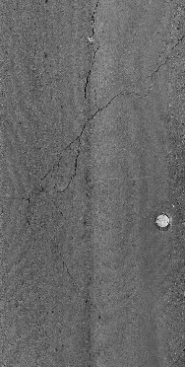
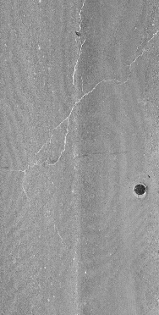
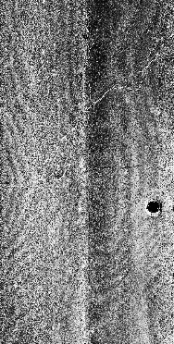
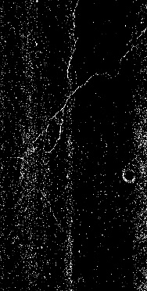
Methodology
Preprocess
To: Denoise the Images
Raw image
Gaussian Filter
Histogram equalization
Normalization: To make the pixel mean equal to zero
(a)
(b)
(c)
(d)

Slide 9
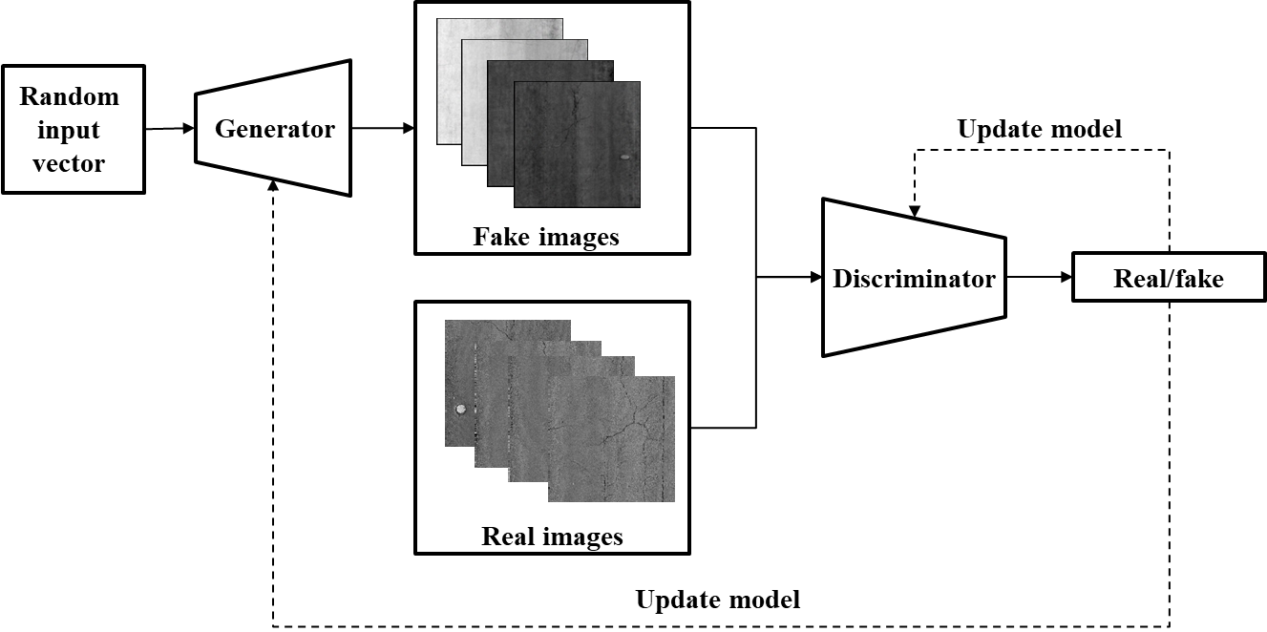
Methodology
Generative adversarial network (GAN)
A class of ML frameworks
Contains two neural networks (G and D) contest with each other
Notes:
The G will generate new images with the same statistics as the training set. And the discriminator will evaluate the results from G. the G ‘s work is to increase the error rate of the discriminative network.

Slide 10
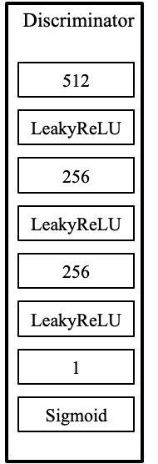
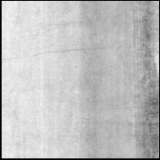
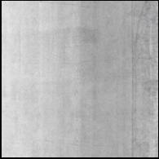
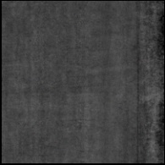
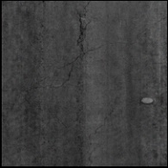
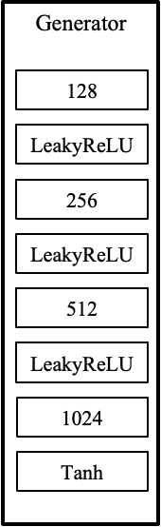
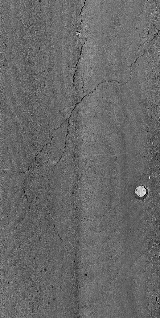
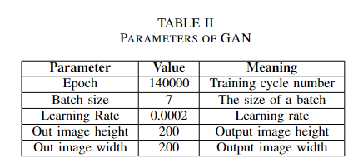
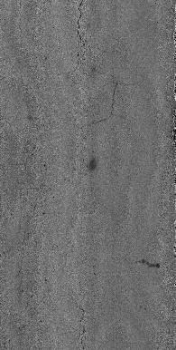
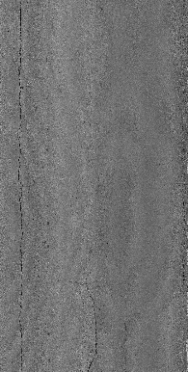
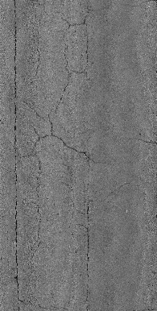
Methodology
Random input vector
Generator:
Deep Neural Network with three hidden layers.
Discriminator:
Deep leaning network with three hidden layers
Fake images
Update
model
Real images
Real/fake
Update model

Slide 11
Methodology
Pavement images
Training
Yolov5
Testing
GAN
Annotation
Validation
The overall procedure
The goal is to train the pavement distress detection model Yolov5, allowing it to learn the features of pavement distresses, and target the objects in top-down view images. Thus, in this work, what we contributes is in the amount of images
Notes:
The pavement images are used to train the GAN model to produce realistic images. Both the real and generated fake images are annotated and split into training data and validation data.

Slide 12
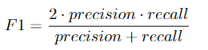
Methodology
Evaluation Metrics
The result is evaluated by F1 score. The F1 metric weights recall and precision equivalently, acting as a good retrieval algorithm, maximizing both precision and recall simultaneously.
Notes:
The pavement images are used to train the GAN model to produce realistic images. Both the real and generated fake images are annotated and split into training data and validation data.

Slide 13
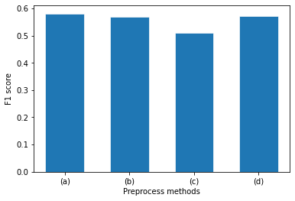
Results
Preprocess
The F1 score decreases after applying the preprocess methods
Image preprocessing may not be a wise decision
(a)
(b)
(c)
(d)
Raw image
Gaussian Filter
Histogram equalization
Normalization: To make the pixel mean equal to zero
Notes:
To analyze why accuracy decreased, the tradeoffs from the preprocessing methods negatively affected our dataset. The Gaussian filter narrows down the boundaries between defects and background, thus reducing the accuracy. The histogram equalization sharpens the contrast; however, the feature of the non-defect area would widen, impacting the accuracy of the model. Subtracting the average value in the pavement image removes the background and noise, along with some useful features from the distress. Thus, image preprocessing in this task may not be considered a wise decision. To improve the model's F1 score, increasing the size of the data set becomes the most optimal choice.

Slide 14
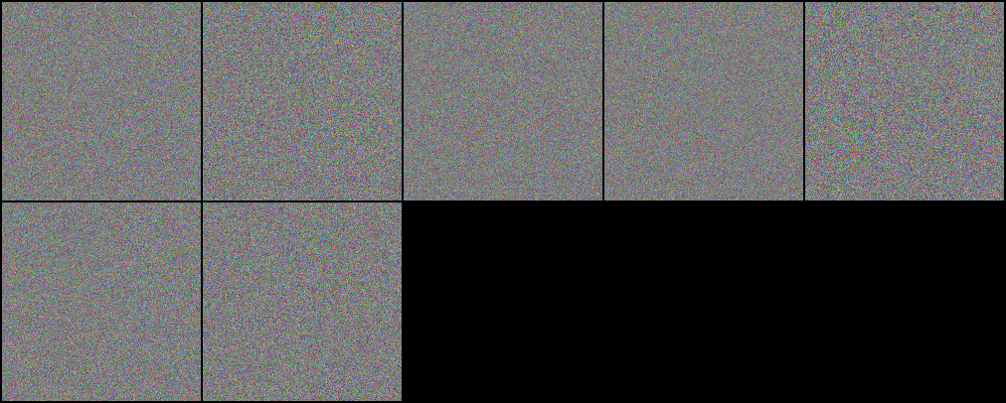
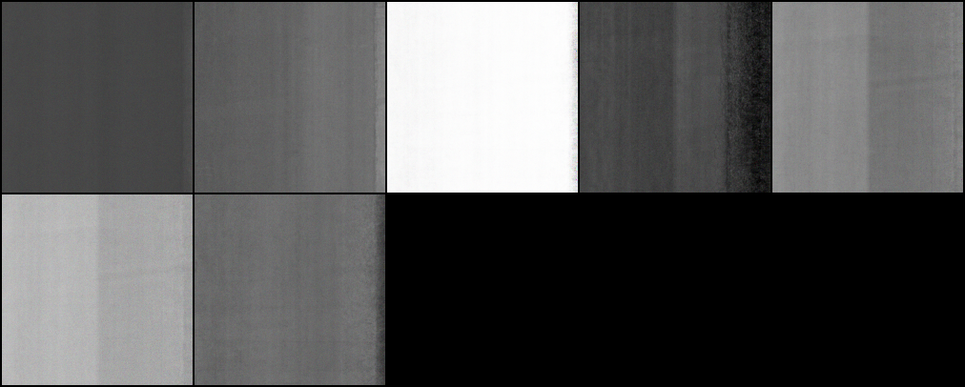
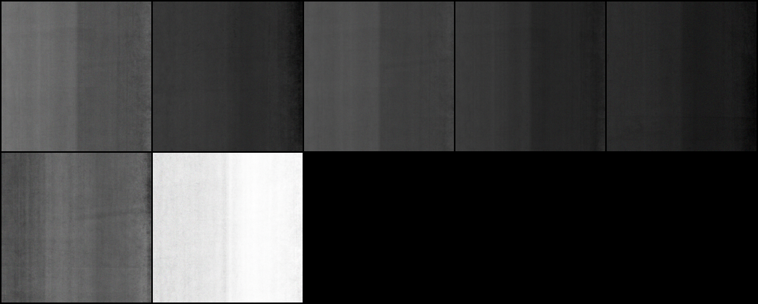
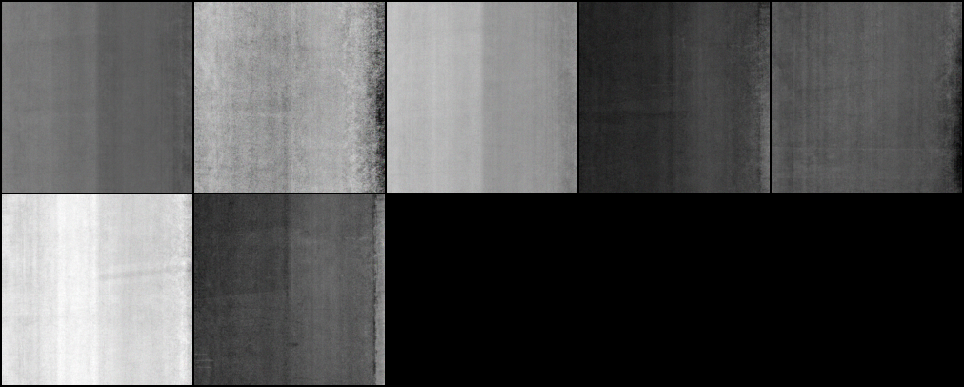
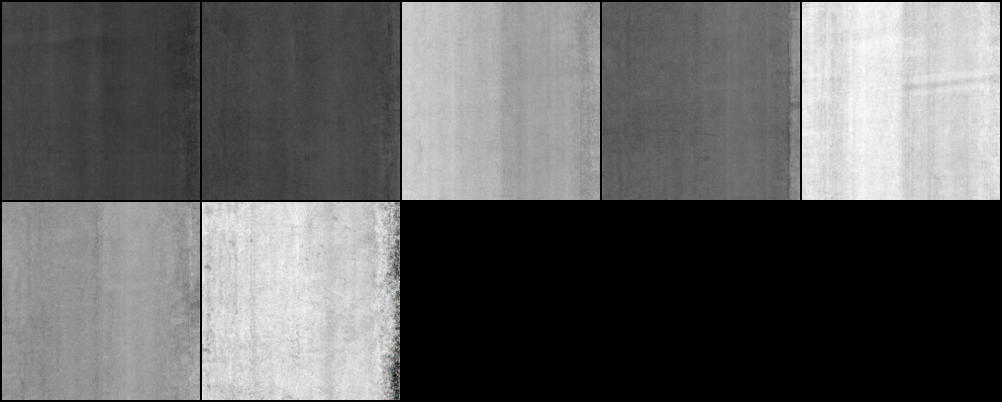
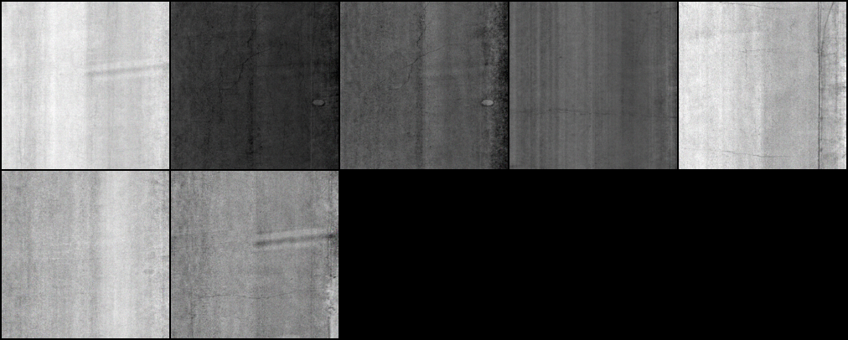
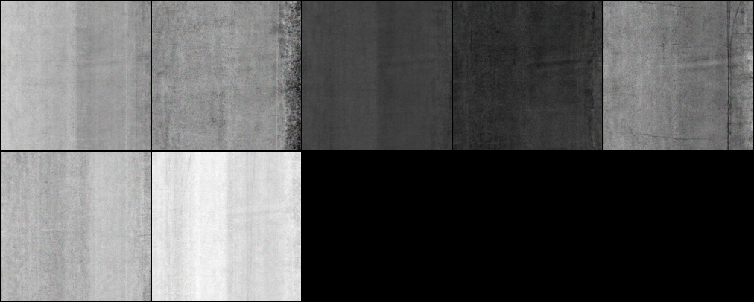
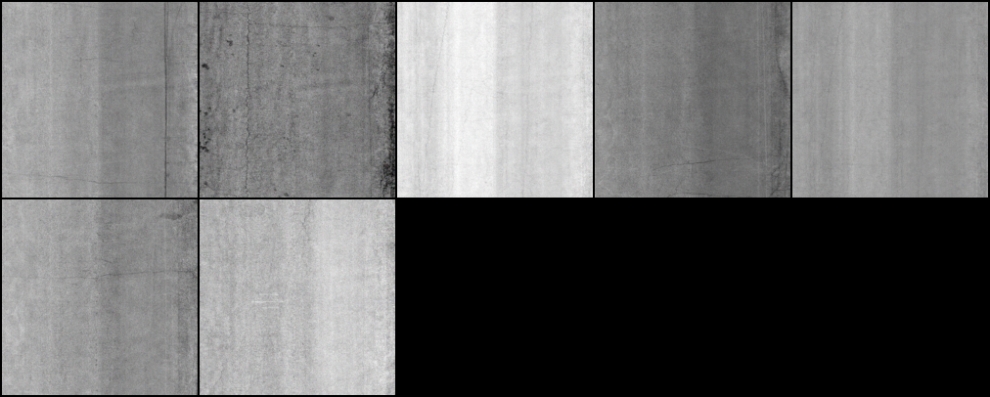
Results
GAN
0
20000
40000
60000
80000
100000
120000
140000
Notes:
To analyze why accuracy decreased, the tradeoffs from the preprocessing methods negatively affected our dataset. The Gaussian filter narrows down the boundaries between defects and background, thus reducing the accuracy. The histogram equalization sharpens the contrast; however, the feature of the non-defect area would widen, impacting the accuracy of the model. Subtracting the average value in the pavement image removes the background and noise, along with some useful features from the distress. Thus, image preprocessing in this task may not be considered a wise decision. To improve the model's F1 score, increasing the size of the data set becomes the most optimal choice.

Slide 15
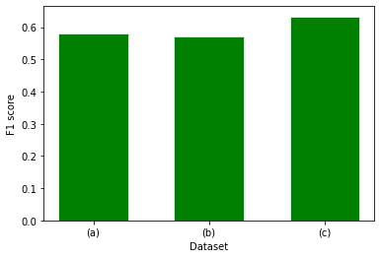
Results
GAN
The addition of fake images brought an increase in the F1 score of 0.633 compared to the raw data accuracy of 0.581.
0
20000
40000
60000
80000
100000
120000
140000
The first release annotated by DSPS;
+the second release annotated by team members;
+the selected 100 fake images.
Notes:
While in the 0 iteration of GAN, the fake image totally consisted of random noise. However, after 100000 epochs of training, the pavement surface image generated by the GAN model is quite similar to the real image, although the area around the distress is still slightly distorted. Thus, 100 fake images were selected after 100000 epochs as an another source of data. The Yolov5 model was tested by using different amount of images.
The addition of the second batch of images resulted in a decrease in the F1 score. The first batch and the testing data were annotated by sponsors of DSPS22, who might have diverse standards when it comes to annotating images. Thus, the outcome would be affected due to their definition of distress, which explains the small drop in the F1 score. Nevertheless, self-annotated images are necessary to the training and validation data, since it is considered as a tradeoff between the accuracy and the model's robustness. The addition of fake images brought an increase in the F1 score of 0.633. The improvement is considered significant, compared to the raw data accuracy of 0.581.

Slide 16
Conclusion
1. Image preprocessing methods such as histogram equalization, Gaussian filter and image normalization decrease the F1 score of the test result showing not a wise way in road distress inspection.
2. GAN can produce fake images to enlarge the amount of train data, as deep learning depends a lot in quality and quantity in the dataset.
3. In the overall procedure, based on the YOLOv5 object detection model, the GAN gains its importance in image augmentation and promotes a better result in the pavement distress inspection.

Slide 17
Thank You
Tianjie Zhang
Boise State University
Email tjzhang@u.boisestate.edu

